Slide 1

End of Capstone I
Grant
Presenters: Grant Saylor, Kyle Smith, Anthony Tran, Jiayi Xu
Notes:
Hi everyone, we are Libraworks, the team behind Virtual Library, we hope this presentation will give you a sneak peek and view into the story of our development to this point.

Slide 2
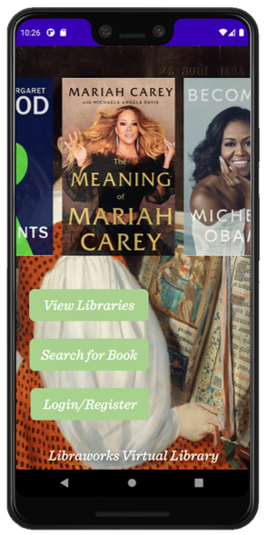
Project Description - Virtual Library
Grant
Who are we?
We call our team Libraworks
Libra coming from the latin word “Taberna Libraria” meaning, place of books.
What is our app?
Virtual Library is an application to create a circulation system for neighborhood libraries.
We wanted to solve the issue of little libraries not having a circulation system to keep track of users and books.
Speaker: Grant Saylor
Notes:
My name is Grant Saylor and I want to talk about some of the inspirations and overviews of our application and team.
We decided to call ourselves Libraworks because “Libra” comes from the Latin word “Taberna Libraria” which roughly means “place of books.” This is thematic to our application, Virtual Library because this app is designed to be a place of books where you can gather many different titles from different places.
Our app, Virtual Library is used to create a software layer on top of a physical real-world location to facilitate the tracking of books and users within a virtual circulation system, much like a real-world library would do with its library card and librarians.

Slide 3


The Inspiration for Virtual Library
Grant
Inspiration for this project came from the combination of Amazon’s internal virtual library system for employees and existing Little Free Libraries.
We wanted a system that was digitized and more modern to enhance the experience of using the Little Free Library system.
Notes:
Virtual Library was originally inspired by Amazon’s internal employee library system, where employees can list and checkout books from one another using an internal service.
As time went on, our app vision grew with our own ideas and events in the real world began to shape the vision of what was the app into a slightly different model where users didn’t have to interact physically with one another to check out a title.
Across North America many neighborhoods have a “Little Free Library” which allows a person to set up a system for patrons to go to a free library set up outside their home and take a book.
The Virtual Library app hopes to add a layer of connectedness and to this system.
In our era of COVID, sharing and borrowing books safely (without contact) can really bring us all together, and having an app that is extensible to add features that users may want allows us to bring people together in a library, virtually.

Slide 4
How a Little Library Currently Operates
Grant
Users take a book/leave a book
There is no tracking of the inventory
Libraries are not catalogued in a formal fashion
Notes:
To give you a quick idea of the landscape we’re working in, currently an existing “Free Little Library” is simply a box with books inside of it. Users can bring their own books for donation, take a book for borrowing and the librarian has no way to really track the inventory or catalogue what books they have in their library unless they manually do this via an excel sheet or word processor. On the next slide you’ll understand a bit better how our app connects with this to make it a more feature rich experience.

Slide 5


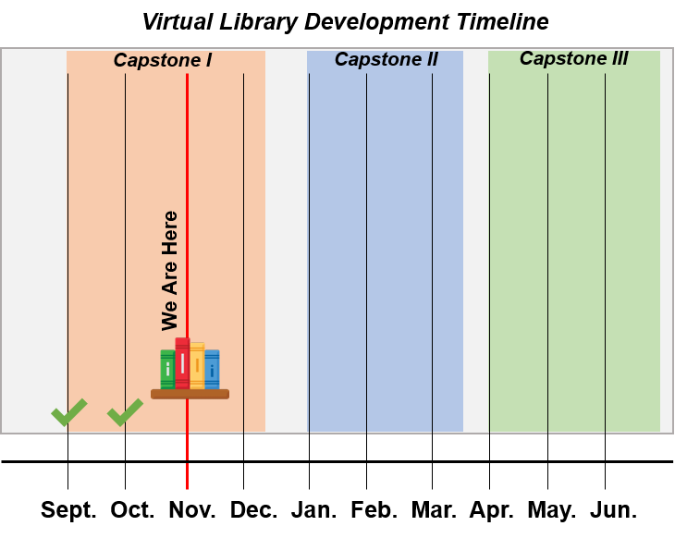
Our Vision
Grant
Libraries are connected to the central database
Improvements upon Physical Little Free Libraries:
Scan books
Use a Map to locate other local Libraries
Book Search Extensibility:
User Profiles
Book Rankings/Requests
Notes:
Throughout development, our vision for Virtual Library has been to improve upon the existing Little Free Library system by adding a software layer on top of the already designed infrastructure. We want our app to allow users to check books in and out of the Virtual Library database so that each library’s database of books can be maintained, books can easily be searched for and users can view a map system to see what libraries are near them. I’ll talk a bit more in-depth about these in a moment.
Furthering our vision, we’ve designed our app so it can be extensible for the future, whether that is adding a full social-network user system or adding a the ability for an in-app request screen so users can ask a librarian to add a book or ask the developers to add a feature.
As you can see from the diagram in the lower right, we are approximately two months into development, we have about nine more months to add features and refine existing functionality into something that is easy and pleasant to use.
Above all else, the app needs to be an easy to use system where any person can use the app without feeling frustrated, we want the app to melt away into your hands.

Slide 6
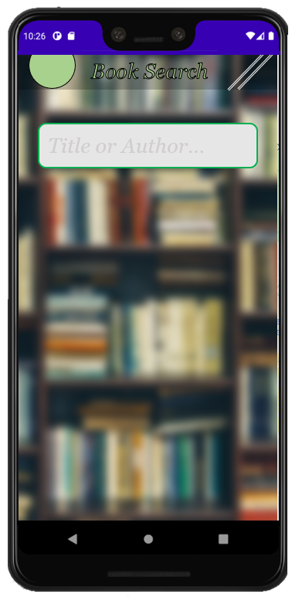
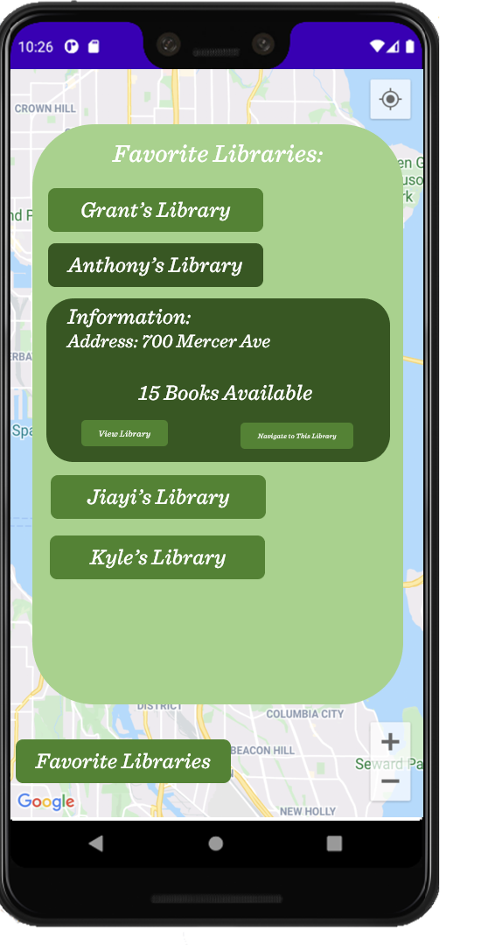
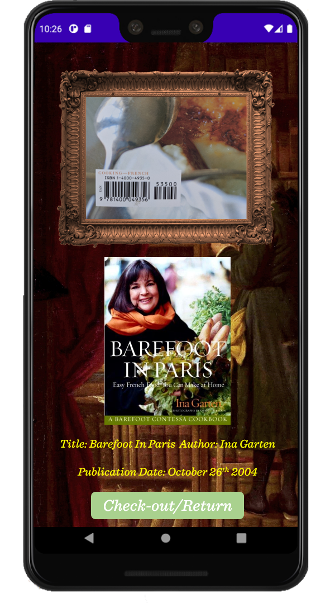
Libraworks Virtual Library - A High Level Overview
Grant
Virtual Library consists of 3 major parts:
Map
Utilizing Google Maps API and User Input for LFL locations
Search
Utilizing Firebase DB to check local inventories
Checkout/in Scan
Utilizing the device’s camera to scan barcodes
Notes:
To give you a high-level overview I want to talk some more about the map, search and checkout components. In order to implement each of these, we must meet our user requirements such as internet and camera access, Jiayi will cover these on the next slide.
At its most basic level, Virtual Library consists of three different screens, the map, the search and the checkout, each screen interacts with each other to provide a full featured experience.
Upon opening the map you’re presented with pins which take you to a library, this utilizes the Google Maps API, but, say you wanted to get to this library screen in a different way, well, you could open up a search screen instead and type the title of the book you want, this utilizes the Firebase Database, filtering in and out the names of the libraries which contain that title.
From there you are presented with a checkout screen, all you have to do is point a camera at a barcode and complete the checkout process, utilizing our last API, the OpenLibrary API, to get the books content (like the title, author and cover.)
Later in the presentation we’ll go more in-depth into each of these main components, but for now I’ll hand it off to Jiayi so she can talk about the user requirements.

Slide 7
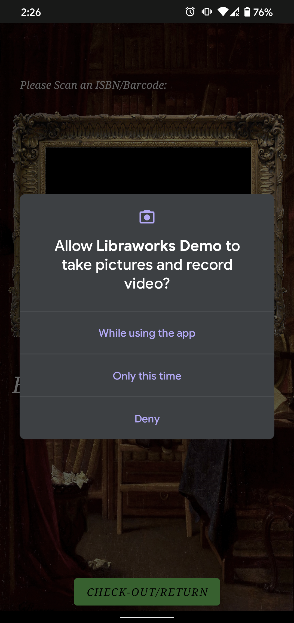
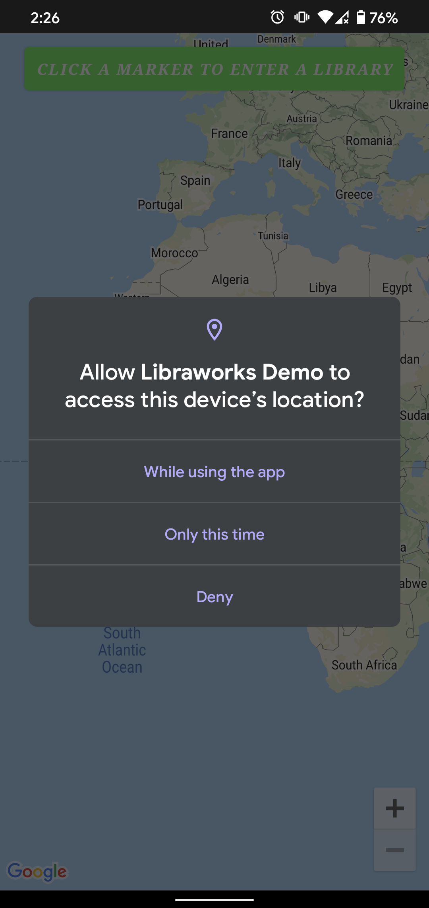
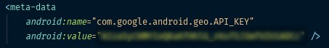
User Requirements
Jiayi
There are a few requirements the user needs before they can use Virtual Library...
Access to the device’s GPS
Internet connection on user’s device
Access to Virtual Library database(s)
Access to the map API
Access to privacy policy/Terms and conditions
Access to the device’s camera
Access to the book database via Firebase
User must have at least Android Version 8.0
Speaker: Jiayi Xu
Notes:
I am Jiayi Xu. Grant mentioned the user requirements of Virtual Library. As you can see, to implement Virtual Library, there are 7 requirements.
These are：“Access to device’s GPS” which can know the location of the user. “Internet connection on user’s device” which can use map and update data in realtime, also to test application and to version control.
The third requirement is about database, I will talk about this part in a few more slides.
The map API requirement is an important feature for the Virtual Library. The map will allow user to see what libraries are near them, Kyle will introduce more information about this part.
The privacy policy is for user registration condition, the camera use is for scanning ISBN numbers, and to access the database is for checking in or out books within our database.

Slide 8
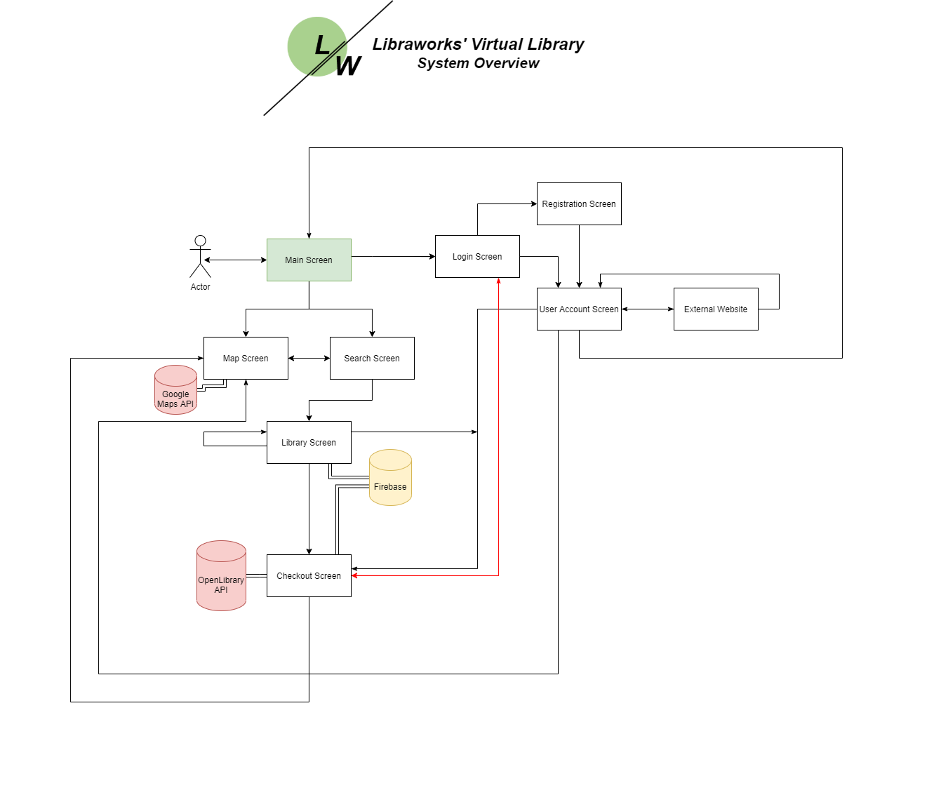
Architectural Design of System
Jiayi
Notes:
· This slide is the architectural design of the system. There are three options on the main screen: the map button, search button, and login button. Buttons on each screen guide user to different interfaces. From the login screen, users can register a new account or log into an existing one.
· The map and search screens will lead user to access the Library screen, this utilizes the Google Maps API
· This system will require user to login if they want to check in or out books. The red arrow shows how a user might be redirected to login when attempting to checkout a book if they are not currently logged in, and then the user would be returned to the screen after.
· The whole system will interact with our Firebase database to locate libraries, catalogue their contents, and allow the users to check in or out books.
· Let’s imagine a use-case scenario. Let’s say you are trying to use our app to locate and check out a specific book. You would open the app and be presented with the main screen. You would then click on the button to search a book and begin entering the requisite information. The search module will be communicating with our database to find that book at a nearby location and present the information to you. Once you select a library from the results, it will take you to the library screen, where you can begin the checkout process. Once you select checkout, you can simply scan the book, the app will communicate with the database and OpenLibrary API that the book is now checked out, and you are good to go!

Slide 9

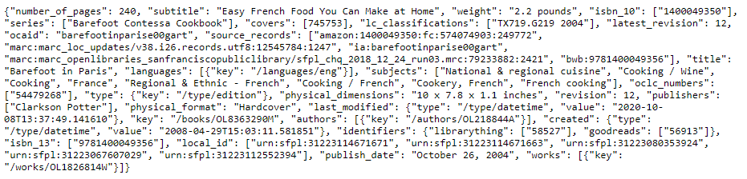
Storing Library Book Inventories
Jiayi
We need to store library locations and their book circulations.
Store book data when users scan them into our system, which can then be used to search and display books
Firebase can update data synchronously
Example of a JSON file stored in Firebase to retrieve data on books:
Notes:
We need a database to hold information about the LFL around the user, as well as the books within our system. It needs to keep track of things like information about the book such as the title, author, publication date, cover, etc. To do this, we are using Firebase as our database for the app.
We want to store our data in Firebase so that we can display the library circulation to users, and they can see what books are available for them to checkout of their local LFL. The information that we are storing comes from the scanning function of our app, which communicates with a book API to give us the book’s information. We also need to be able to create new library locations for other LFL in the area. We hope to have users of the app submit locations of LFL to be included in our app, which will have their locations stored in the database, and we can then populate their circulations with the books available.
Initially, we encountered a problem uploading information to the database, and had to learn more about how to interact with it from within both the app as well as Android Studio. With Firebase, we are able to monitor changes to the database instantaneously, and were able to check that the correct information was being uploaded when we would use the scan function.
This aspect of our program is teaching us lots of new things -- we are able to take a lot of things we’ve learned from Database Systems class and apply it to this No-SQL database, but there is still a lot to learn when using it in the real world.
Kyle will continue to introduce more details about Virtual Library..

Slide 10
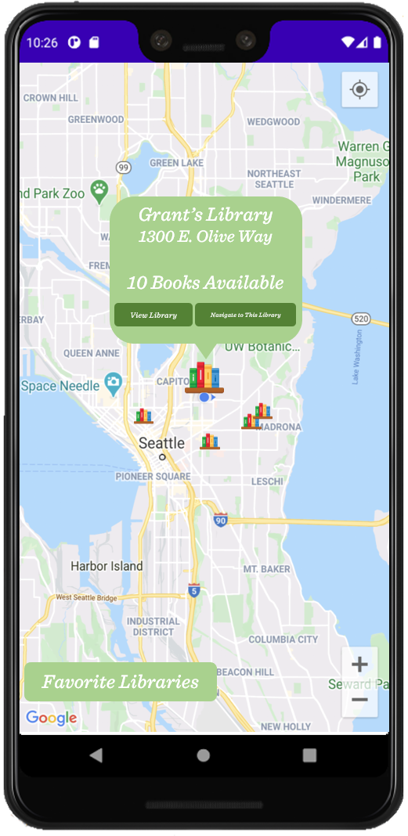

Map API Implementation
Kyle
The Problem: Finding Little Free Library locations is a pain.
The Solution: We can use Google Maps API.
The map is powerful and flexible, it is malleable to your needs.
Implementation introduced some issues, such as populating the map or displaying pins.
Speaker: Kyle Smith
Notes:
Hi everyone, I’m Kyle, and I’m going to be talking more in detail about some of our major features for our app. First up is the Map API. One of the issues we are trying to solve with this app is the fact that LFL can be hard to find. We wanted there to be an easier way for users to discover these locations in their local area. The solution comes from Google Play Services, their Maps API, and is allowing us to use their product for the basic functions of a map like zooming, location data, and so forth. We decided to use this, as it was very easily integrated into android applications and is the leading map API. The map is also highly customizable with features like changing the screen space it uses, the ability make custom pins, having interactable features within the marker, and so forth, so we will have many options to play with in the coming months.
Initially we had some issues with our map API, specifically we were struggling with the pin system and how they would populate on the screen and contain information. Later on in our demo you’ll see the current implementation which only includes a single pin, but we hope the final iteration will look more like the image shown on the right, with many libraries scattered about the screen, with some details for each upon clicking them. We are still learning the ins and outs of the system, and still have work to do with the map, so our current implementation is not representative of the final product. We are hoping to adjust some ways that users interact with the map to limit their scope to their local area. What defines the ‘local area’ for LFL to populate is still up for debate for now.

Slide 11
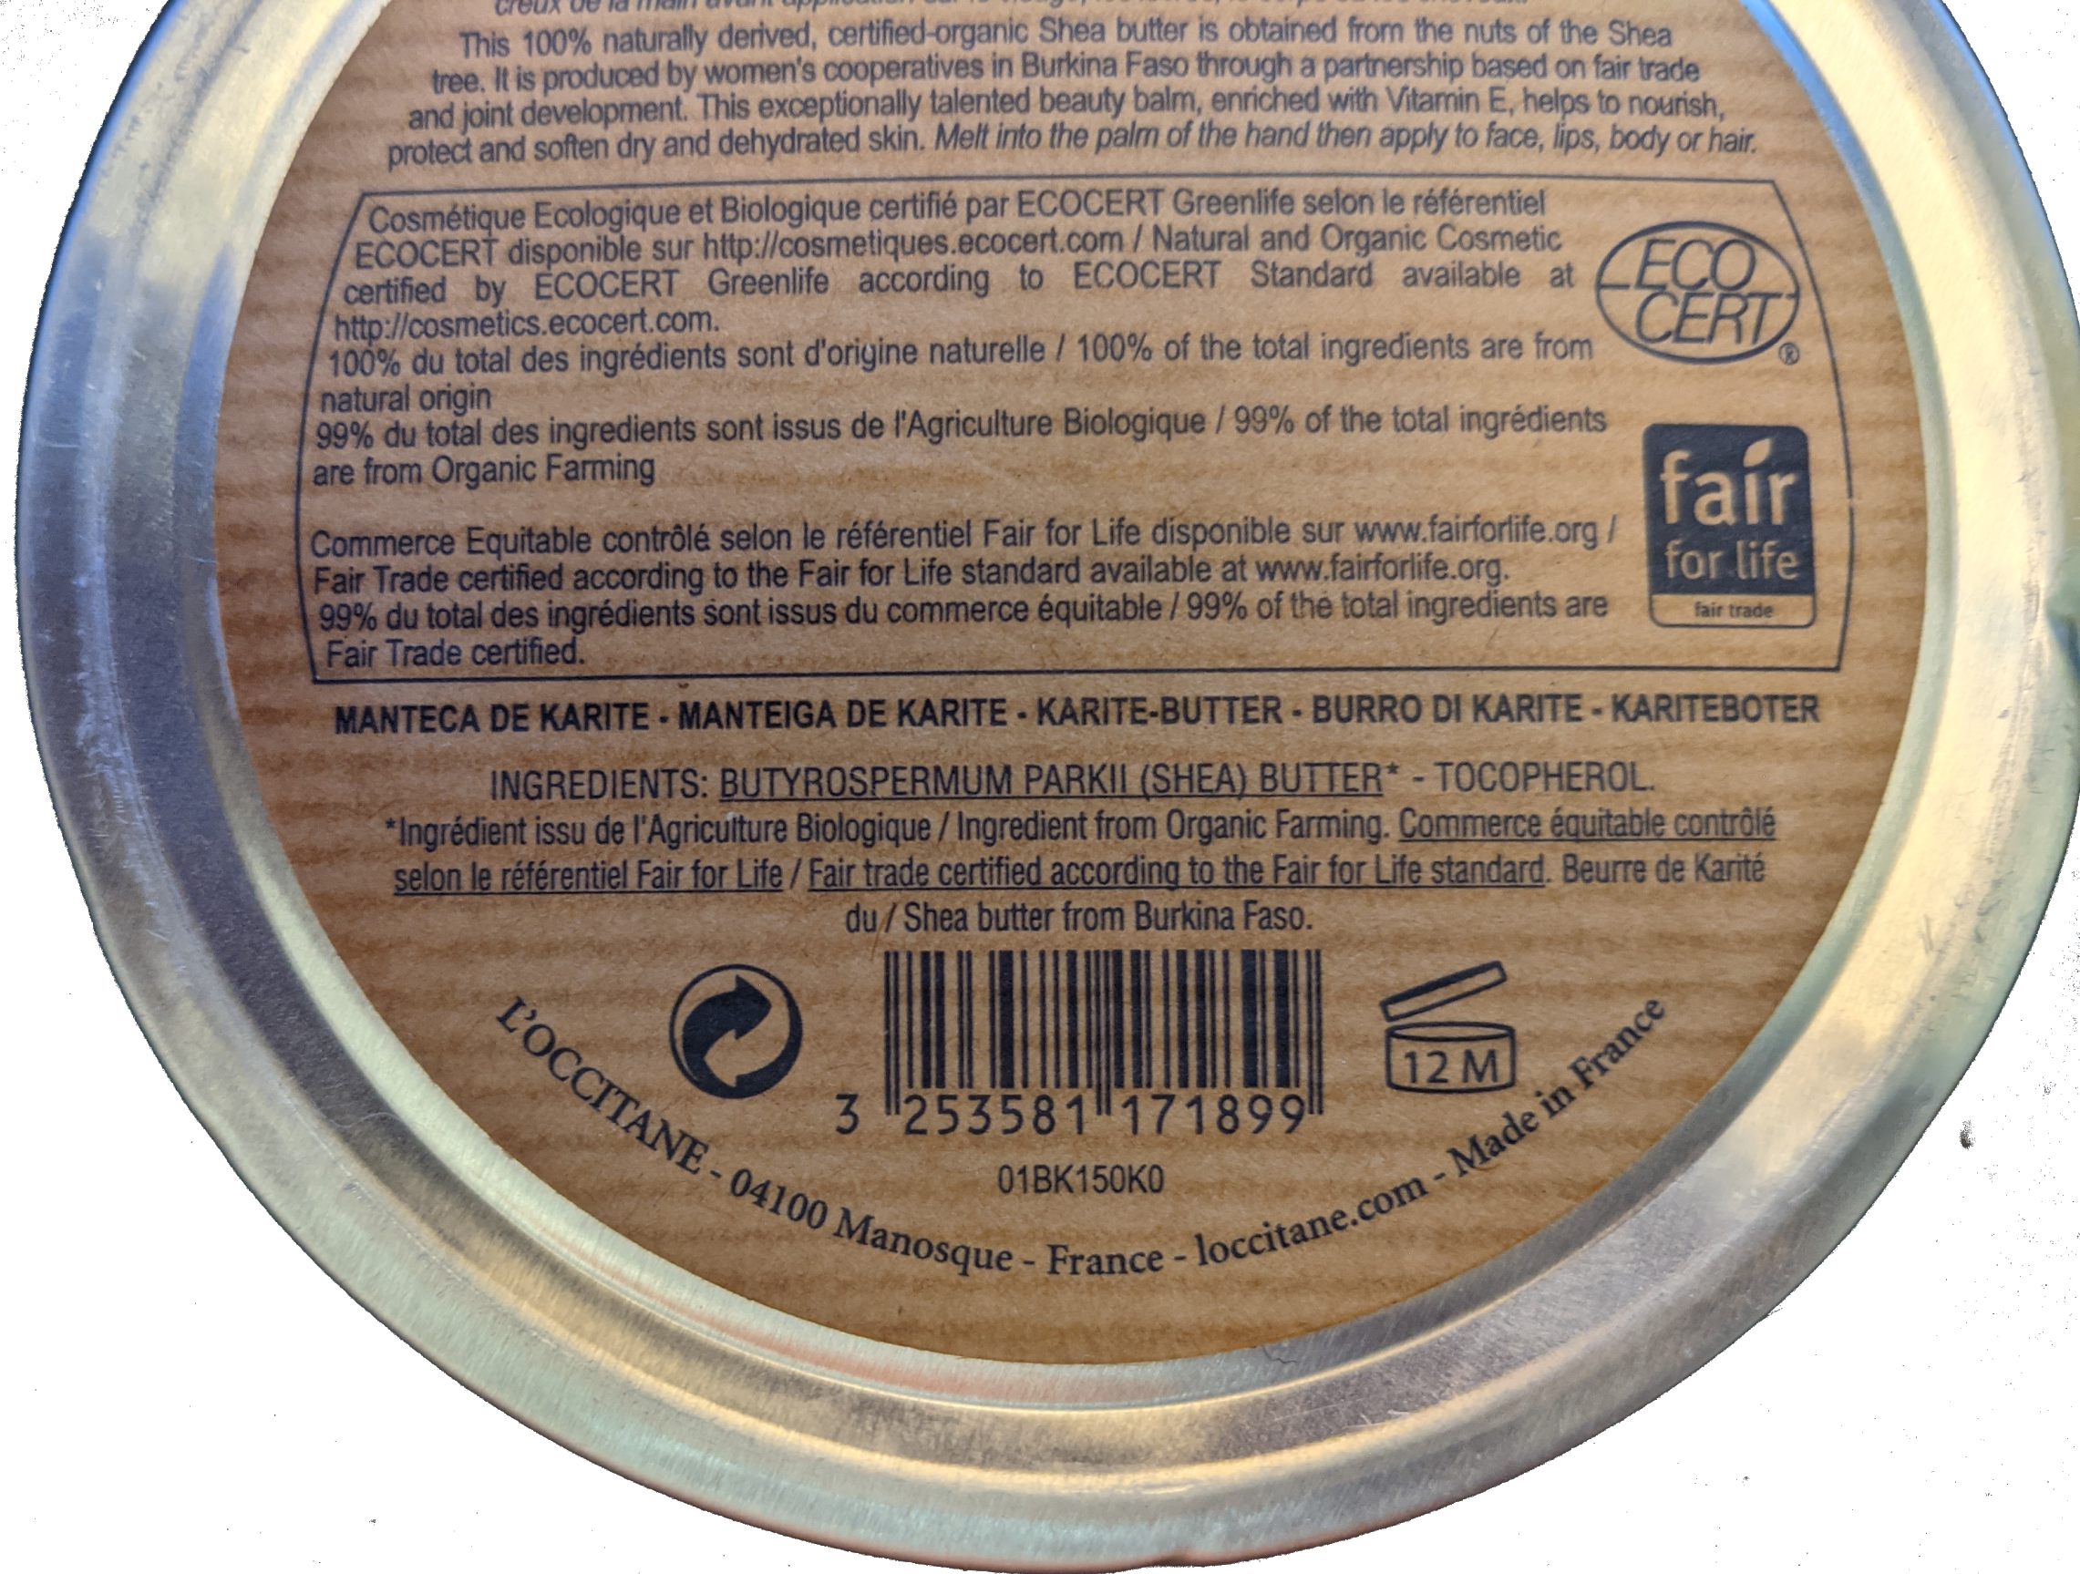
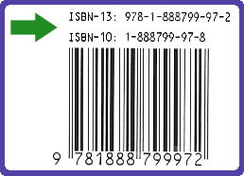
Scanning Functionality
Kyle
X
The Problem: How can we make it easy to check in/out books
The Solution: A simple scanning module.
What do we do if the ISBN is invalid?
What did we learn? So much about ISBN!
Not a book!
✔
Valid ISBN!
Notes:
The second major piece of our app is the scanning feature. We needed a way to keep track of where books were and whether they were available or not at libraries, so the solution is an easy-to-use scanning tool to minimize the amount of work needed by the user. Ease of Use is one of the main tenets of the entire app so that people don’t feel bogged down by this addition to the LFL ecosystem, but it was especially important here. We didn’t want users to have to manually enter information each and every time they do a checkin/out, so this was the perfect solution. As you’ll see in our demo, the scan works extremely quickly and the book can then be checked in/out at the push of a button. The inner workings of this feature will be expanded upon by Anthony a little later, but the simple version is that it uses the device’s camera to detect a barcode and generate an ISBN number if the barcode is the correct type. We are then able to use that ISBN together with our books API to pull relevant information about that book, and quickly either add it or adjust it within our database.
Luckily for us, the scanning feature is actually a Google-offered API, so implementing it was actually quite simple. We didn’t run into any snags with the behavior of the module when using it on real book barcodes, but Anthony will speak about non-optimal cases and how we deal with those.
You can see in our images an example of an EAN barcode not associated with a book and also an ISBN with both a 10 and 13 number code.
For testing purposes we needed to check that books with ISBN-10, ISBN-13 and both 10 and 13 were tested for compatibility.
Some things we learned from implementing this is how barcodes are codified to differentiate different products from one another. It’s also interesting to note that the ISBN-10 code for books is an older format that has been integrated into the new ISBN-13 code, so any books printed before 2007, when ISBN-13 was created, will have both an ISBN-10 and ISBN-13.

Slide 12
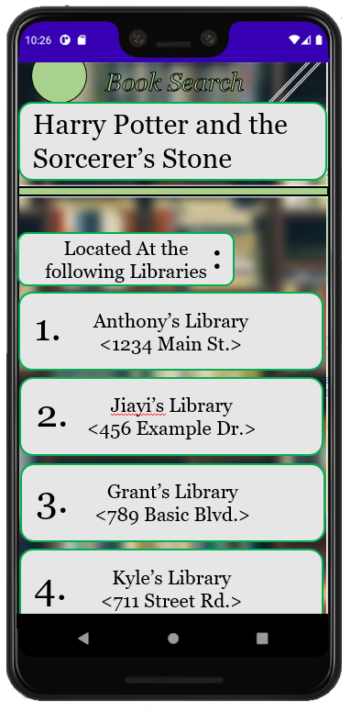
Search Function
Kyle?
No, this is Patrick
The Problem: It doesn’t feel good going out to a Little Free Library and it not having anything you want.
The Solution: A search book feature.
What about mistyped searches?
How can we apply techniques from Database Systems?
Notes:
The final major part of our app is the search function. Our team needed a way for users to be able to locate books of interest in their local LFLs, because a common experience of using them is that you may walk away empty handed. We wanted a way to make sure users could track down specific books so they can always have a good outcome when they use LFLs. Our solution is a search within the app that would query our database to check if 1) the book exists in any library’s circulation, and 2) if the library or libraries that have it are ‘nearby’. Once again we are still working on exactly what ‘nearby’ will mean for our app.
Once that search has finished, it will show the results of the search to the user. You can see a UI sample of this on the right, where a user searched for the first Harry Potter book, and libraries that have the book and are close have populated on the screen. From here, the user can tap on a library result, which will take them back to our map to show them where it is.
The search function for now is not fully implemented, so we’re not quite at the point of testing or finding issues with it, but we know we need to consider cases where users search for things that are spelled incorrectly, or other misuse cases.
As mentioned before, our database is No-SQL so we will be relearning many topics from our class on DBMS while we implement this feature.

Slide 13



Experiences
Kyle
Everything in this project was new to us
Android Studio
Mobile Application Development
Kotlin language
Firebase Integration
Usage of APIs
We learned to overcome issues surrounding these new mediums and have become more proficient. There’s still much to learn for the upcoming Capstone classes.
Notes:
As far as new experiences go, this capstone project has been a wealth of them. The four of us have all been put out of our comfort zones while working on our project. From the IDE we work in to the API calls we make, everything we are working on is a new experience to us. Everytime we move on to a new aspect of our project, we each need to do some research on what it is and how we can mold it to fit our needs and the needs of the app. I think that we’ve made great progress from where we started at the beginning of capstone, but we still have so much more to learn and adapt as we continue turning our project into a fully realized vision of what we want it to be.

Slide 14
Demonstration
(Recorded on Actual Android Hardware)
Live
Demo
Anthony
Speaker: Anthony Tran

Slide 15
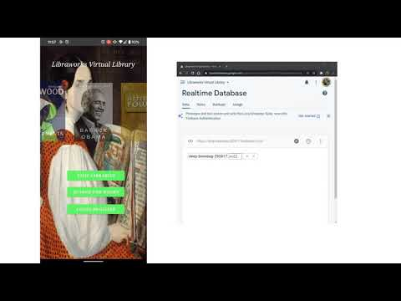
Live
Demo
Anthony

Slide 16
Testing
Anthony
Various ISBN types were tested (ISBN 10, 13, combo of both)
The ISBN is stored in our firebase after scanning, so we needed to test grabbing the JSON file.
Some other testing included scanning non barcodes.
Notes:
We tested our application’s ability to read and store ISBN’s by scanning various ISBN of different books.
Each time we scanned a new book, the corresponding json information is stored in our firebase in real time.
When we scan an invalid barcode or scan nothing, then it would just push null information onto firebase, indicating either there was nothing to scan or we scanned something wasn’t a book ISBN. The next slide I’ll show you some of these use cases.

Slide 17
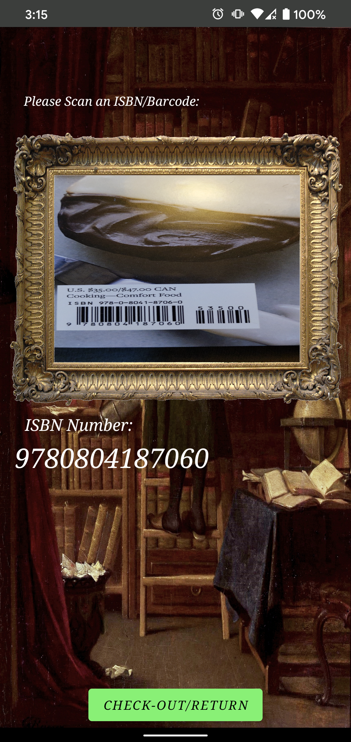
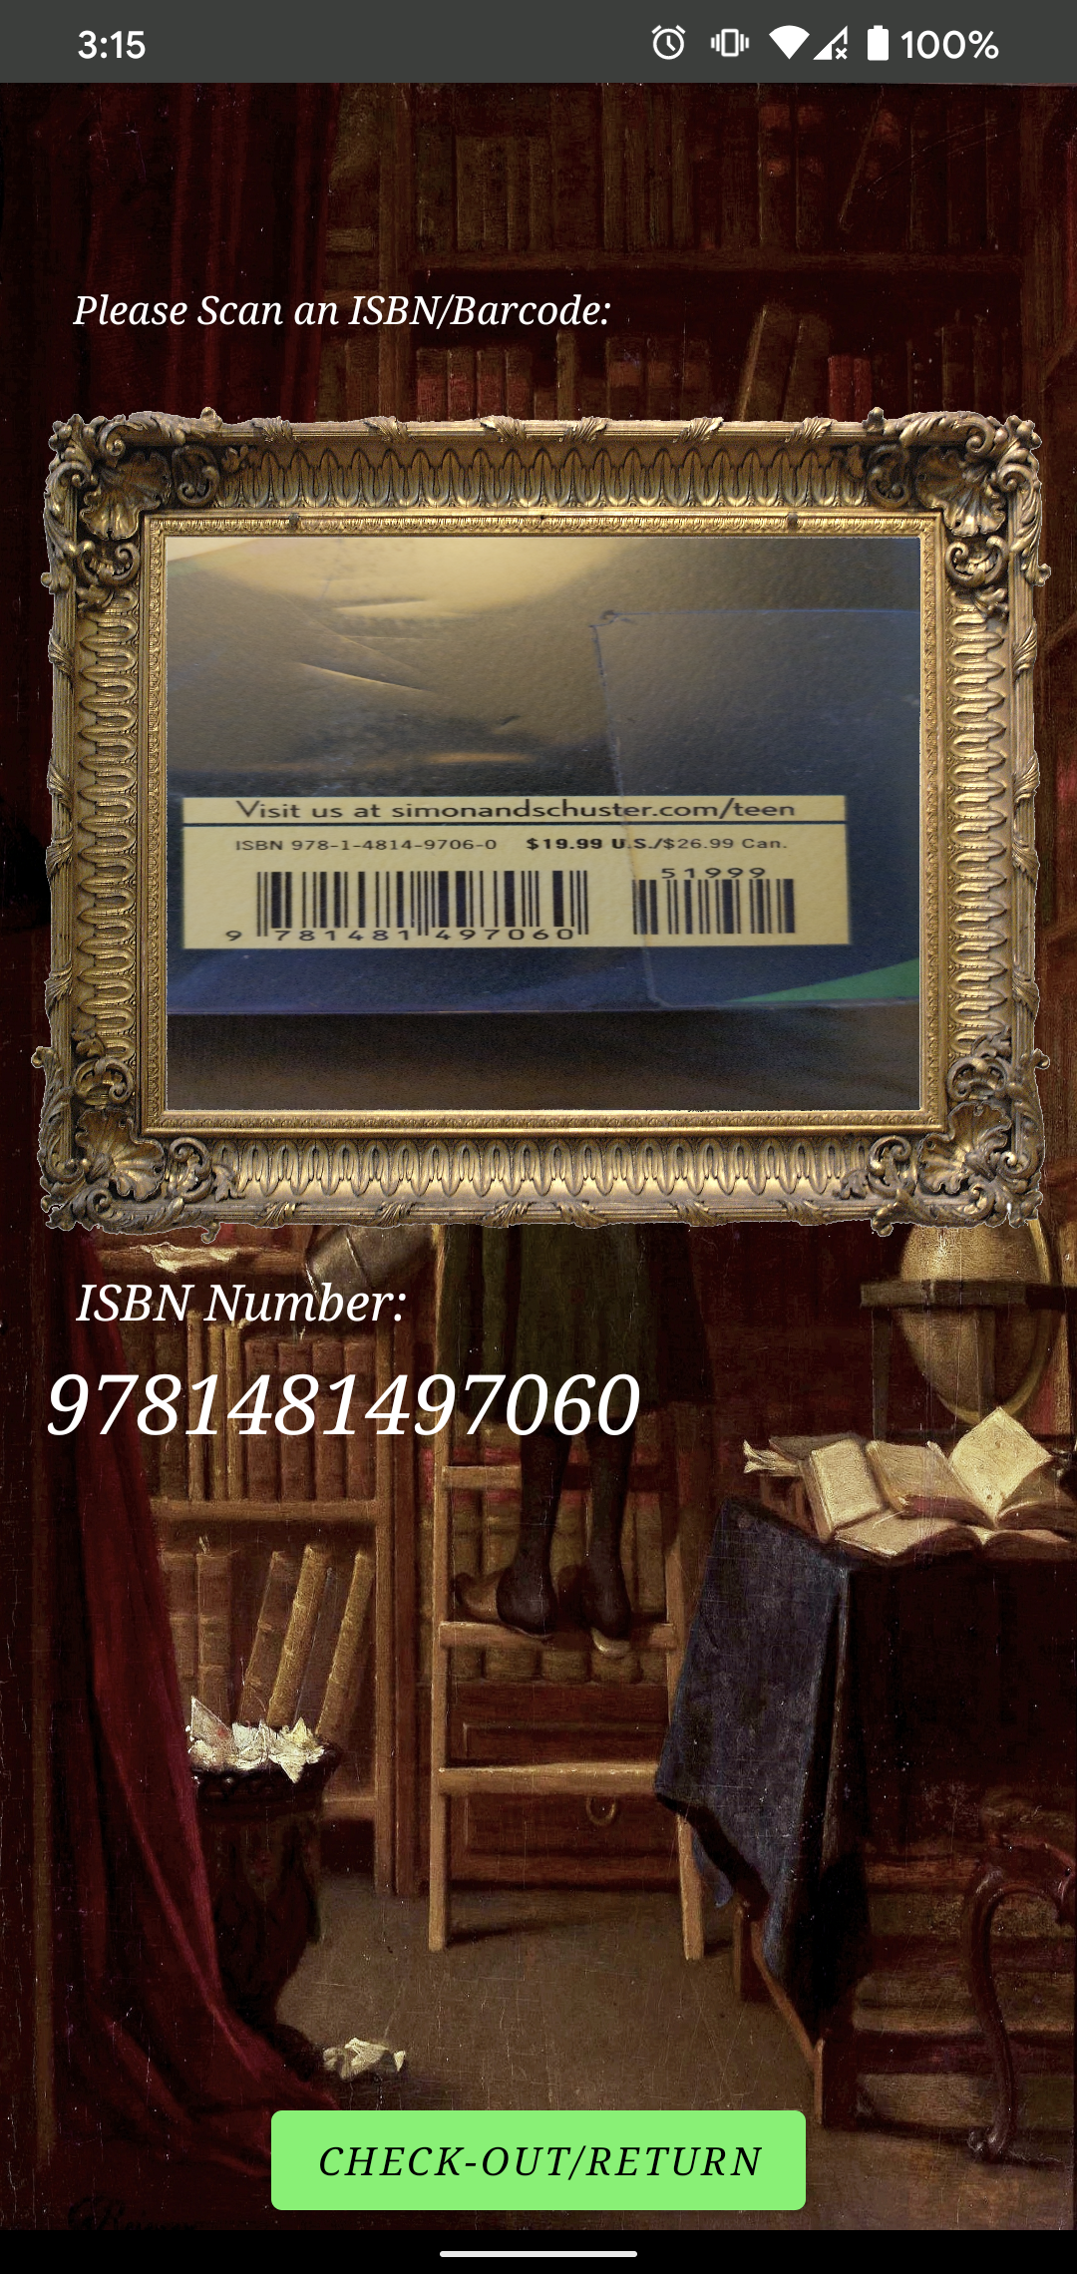
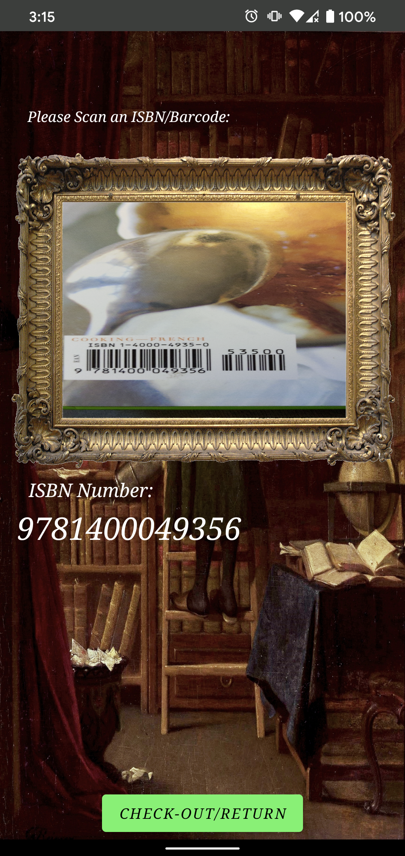
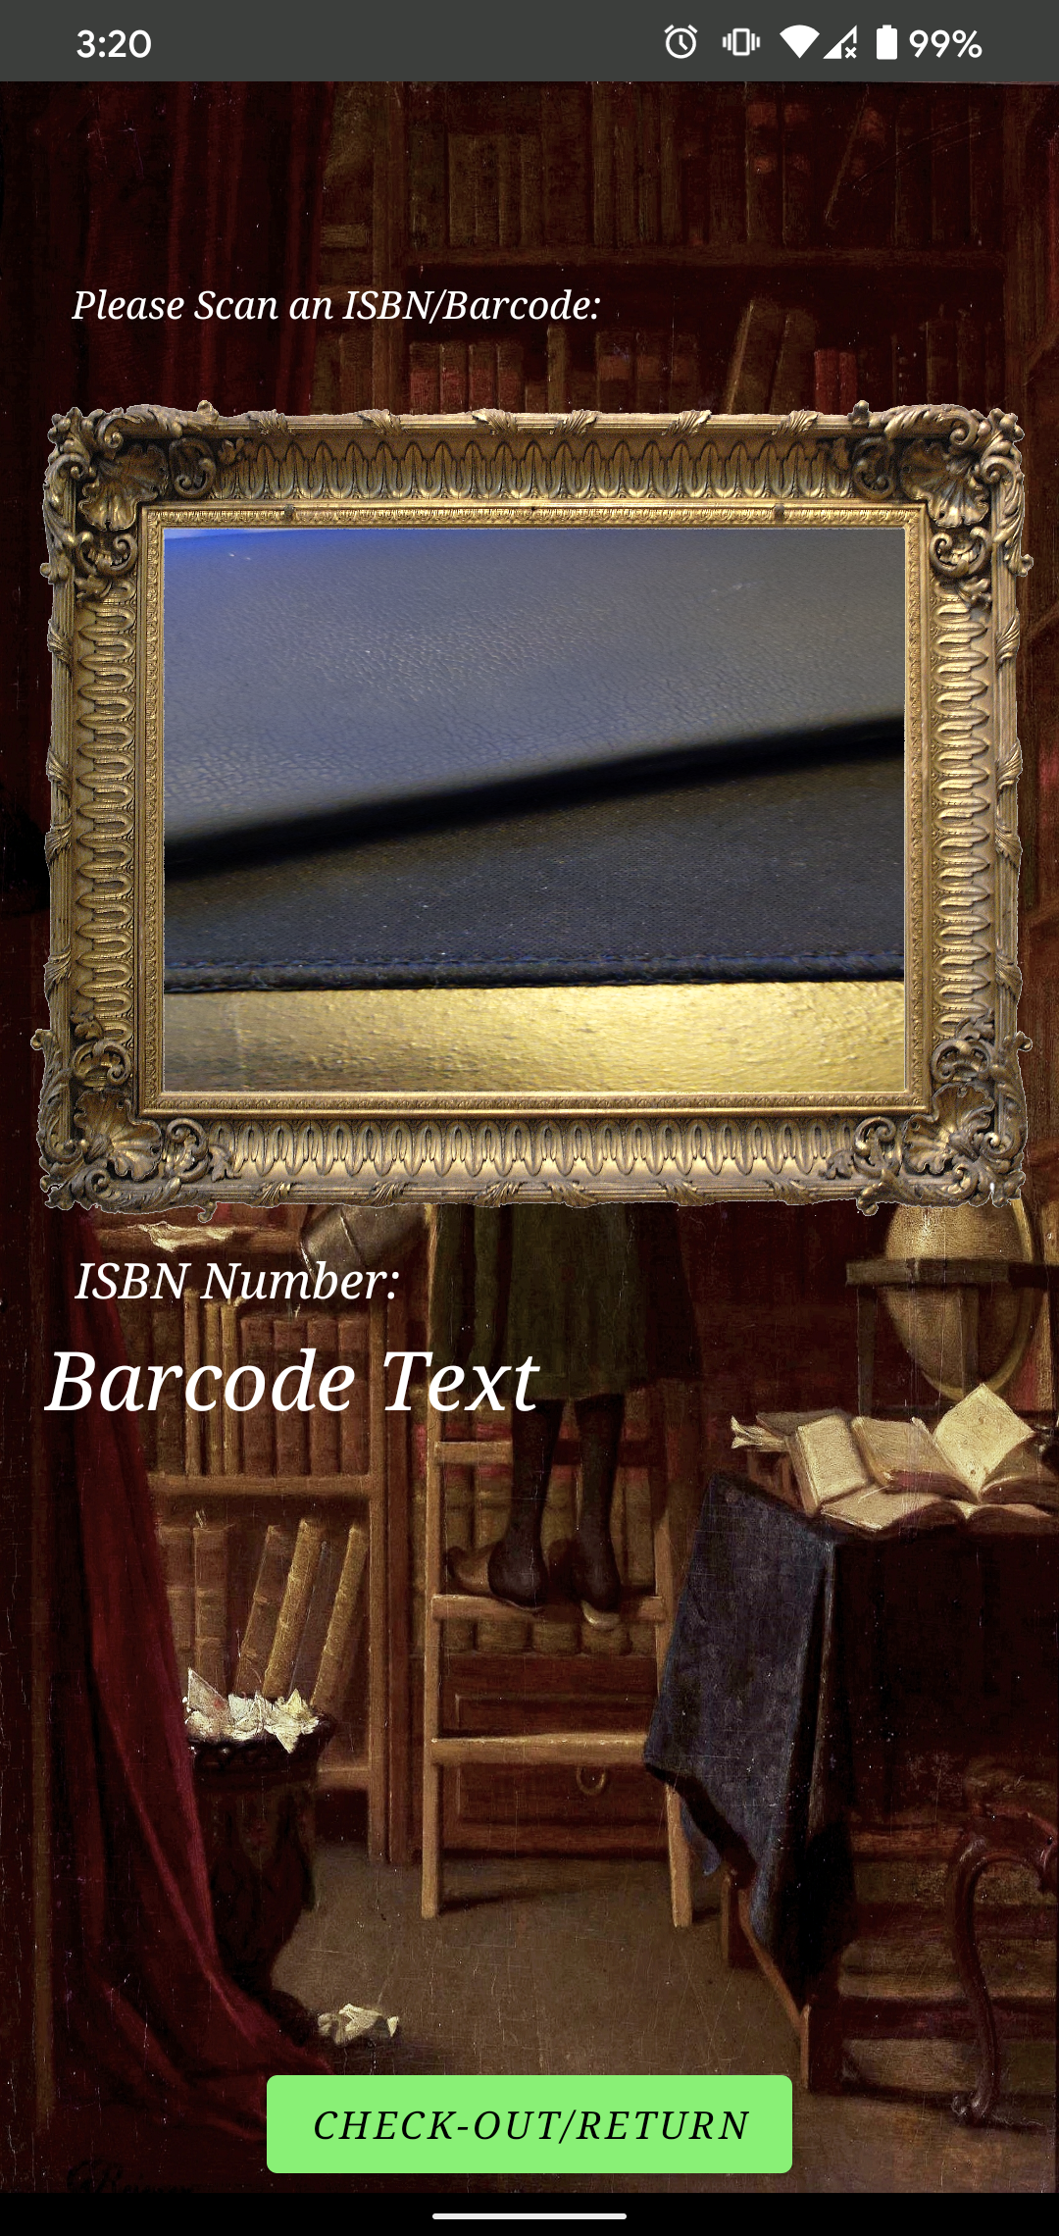
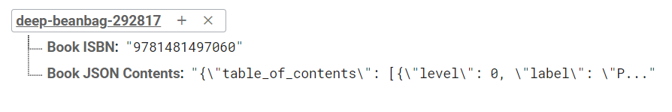
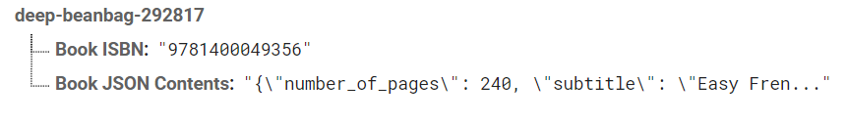
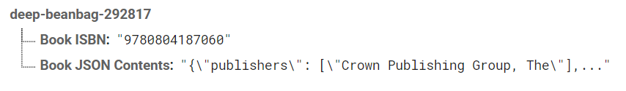
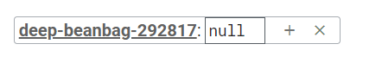
Anthony

Slide 18
Future Work:
Anthony
Implementing a more robust database system to store many books
Complete the login functionality
Add further functionality to the map (I.e. add more libraries, favorites)
Implementing all error messages

Slide 19
Development Tools Sources:
Anthony
Firebase: https://firebase.google.com/
Android Studio: https://developer.android.com/studio
Maps SDK: https://console.developers.google.com/apis/library/maps-android-backend.googleapis.com
ISBN Tutorial: https://medium.com/analytics-vidhya/creating-a-barcode-scanner-using-android-studio-71cff11800a2
Maps Tutorial: https://www.raywenderlich.com/230-introduction-to-google-maps-api-for-android-with-kotlin
Diagram.net (Formerly Draw.io): https://app.diagrams.net/
OpenLibrary API: https://openlibrary.org/dev/docs/api/books

Slide 20
Public Domain Artwork Licenses:
Anthony
Main Screen: https://commons.wikimedia.org/wiki/File:Auguste_de_Chatillon_-_L%C3%A9opoldine_Hugo.jpg
Barcode Screen: https://commons.wikimedia.org/wiki/File:Reimer_Librarian.jpg
Barcode UI: https://www.flickr.com/photos/34651674@N07/7258061584/
Librarian Screen: https://www.pexels.com/photo/blurred-book-book-pages-literature-46274/
Library and Login Screen: https://images.nga.gov/?service=asset&action=show_zoom_window_popup&language=en&asset=66024&location=grid&asset_list=109948,76165,66024,49028,148908,149152,149498,149347,149528,148885,149267,149357&basket_item_id=undefined

Slide 21

Thank You for Watching
Anthony

